Slide 1

AI-Based Crime Prediction and Hotspot Detection System for India
Bullam Sagar 22AJ1A5810
Rangisetty Aravind 22AJ1A5848
Devireddy Leela Nageshwar Rao 22AJ1A5805
Kalathoti Meghana 22AJ1A5814
BATCH NO: 5
UNDER THE ESTEEMED GUIDANCE OF
Ms.Erupula Babitha
DEPARTMENT OF COMPUTER SCIENCE AND ENGINEERING
AMRITA SAI INSTITUTE OF SCIENCE AND TECHNOLOGY
Paritala , Vijayawada , Andhra Pradesh(521180)

Slide 2
INDEX :
Problem Statemen
Objectives
Proposed Solution
Modularization of Project
Key Features
Data Preprocessing & Feature Engineering
Design Methodology
Project Demonstration
Test Case Specifications
System Architecture
Results
Conclusions
Future Scoping

Slide 3
Problem Statement
Crime rates in various regions are increasing, making it difficult for authorities to ensure effective monitoring and prevention.
Existing systems mainly rely on historical data and lack the ability to predict future crime trends.
There is no efficient mechanism to identify crime hotspot areas in advance for better planning.
Traditional methods do not provide geographical visualization, limiting understanding of crime distribution.
Law enforcement agencies face challenges in optimal resource allocation and timely decision-making.
As a result, preventive measures are often delayed, affecting overall public safety and security.

Slide 4
Objectives
To develop a system that analyzes historical crime data for pattern identification. To predict future crime occurrences using machine learning techniques.
To classify regions into High, Medium, and Low risk zones using clustering algorithms. To integrate both crime density and severity for accurate hotspot detection.
To visualize crime-prone areas using an interactive map (Leaflet / Google Maps). To represent data in a hierarchical structure (State → Risk Level → District).
To assist authorities in efficient decision-making and resource allocation. To enable proactive crime prevention and improve public safety.

Slide 5
Proposed Solution
Develop an AI-based platform to analyze and predict crime trends using historical data.
Implement a hybrid risk assessment approach by combining K-Means clustering (relative analysis) with absolute crime thresholds for accurate classification of regions into High, Medium, and Low risk levels.
Apply machine learning models (Random Forest Regression) to forecast future crime occurrences based on past trends.
Perform feature engineering using lag values and rolling averages to capture crime patterns over time.
Provide interactive geographical visualization using Leaflet/Google Maps with color- coded markers for easy identification of crime hotspots.
Design a hierarchical data structure (India → State → Risk Level → District) for clear and organized representation.
Enable authorities to take data-driven decisions, optimize resource allocation, and implement proactive crime prevention strategies.

Slide 6
Modularization of Project
Frontend Module (React / Vite) Handles user interface and interaction
Includes components for: Map visualization (Leaflet),Risk tree display,User input forms
Backend Module (Flask / Python) Manages API requests and business logic
Connects frontend with machine learning models and data
Machine Learning Module
Performs crime prediction and hotspot detection
Uses: Random Forest (prediction) and K-Means Clustering (risk classification)
Data Processing Module: Handles data cleaning, transformation, and feature engineering Prepares historical crime data for model training
Visualization Module
Provides interactive maps and hierarchical views Displays results in an intuitive and user-friendly format
Database / Data Storage Module
Stores crime datasets, model files, and spatial data (coordinates)

Slide 7
Key Features
Spatio-Temporal Hotspot Mapping:
Interactive Leaflet map with real-time hotspots and color-coded risk levels (High, Medium, Low) along with detailed district information.
Predictive Crime Forecasting:
Uses Random Forest model to forecast future crime trends based on historical data and district-level patterns.
Hybrid Risk Assessment Engine: Combines K-Means clustering and threshold logic for accurate and dynamic risk classification.
Hierarchical Risk Tree:Displays structured data as State enabling quick identification of high-risk areas.
User-Friendly Dashboard:
→ Risk Level → District,
Modern, high-contrast interface with smooth transitions and interactive visualizations.
Complete Map Coverage:
Ensures all districts are visualized using intelligent coordinate fallback for missing location data.

Slide 8
Data Preprocessing & Feature Engineering
Data Cleaning:
Handle missing values, convert crime counts to numeric, and standardize structure.
Data Filtering:
Remove aggregate entries and focus on district-level crime data for accuracy.
Feature Engineering:
Create lag features (previous years) and rolling averages to capture crime trends.
Categorical Encoding:
dataset
Transform State, District, and Crime Type into numerical values using techniques.
Geospatial Mapping:
Assign latitude and longitude to districts for map-based visualization.
Data Splitting:
Divide dataset into training and testing sets for model building and validation.
encoding

Slide 9
Design Methodology
Data Engineering: Process district-level crime data with preprocessing, feature engineering (lags & rolling means), and encoding for ML readiness.
Predictive Modeling: Use a dual-model approach:
Regression model for crime count prediction
Trend classifier for predicting increase/decrease patterns
Dynamic Prediction Logic: Combine regression output with trend classification to ensure accurate and consistent forecasts.
Hotspot Detection: Apply hybrid logic:
K-Means clustering for relative risk Threshold-based classification for severity Final risk = maximum of both
Geospatial Visualization: Display results using Leaflet maps with color-coded risk zones and hierarchical tree structure.
System Integration: Built using Python (Flask), Scikit-learn, React, Tailwind, and Leaflet for a complete full-stack solution.

Slide 10
Project Demonstration
User Input: The user selects State, District, Year, and Crime Category through an interactive dashboard.
Crime Prediction: The system uses trained machine learning models to predict future crime count based on historical data.
Hotspot Detection: Districts are analyzed and classified into High, Medium, and Low risk zones using clustering techniques.
Map Visualization: The results are displayed on an interactive Leaflet map with color- coded markers for easy identification of hotspots.
Hierarchical Representation: Data is organized as State → Risk Level → Districts, helping users quickly understand the distribution of crime.
Insight Generation: The system provides clear and real-time insights to support decision- making and proactive crime prevention.

Slide 11
Test Case Specifications
TC-01: Data Integrity & Parsing:
Verify that the backend correctly loads the dataset and removes aggregate entries to ensure accurate analysis.
TC-02: Predictive Accuracy (Regressor):
Validate that the model generates realistic crime predictions using historical data patterns.
TC-03: Trend Alignment (Classifier):
Ensure the system correctly identifies crime trends (Increase/Decrease) and aligns predictions accordingly.
TC-04: Hybrid Hotspot Detection:
Verify correct classification of districts into High, Medium, and Low risk using clustering and threshold logic.
TC-05: Geo-Spatial Visualization:
Confirm that hotspots are accurately displayed on the Leaflet map using proper coordinates.
TC-06: Hierarchical Data Synchronization:
Ensure the risk classification tree matches the backend hotspot results.

Slide 12
System Requirements
Hardware Requirements
Processor: Intel i5 / AMD Ryzen 5 (or equivalent) RAM: Minimum 8GB (16GB recommended) Storage: At least 1GB free space
Display: 1366×768 (1920×1080 recommended)
Software Requirements (Backend) OS: Windows / macOS / Linux Python: Version 3.8+
Libraries: Flask, Pandas, Scikit-learn, NumPy, Joblib Software Requirements (Frontend)
Environment: Node.js (v18+) Frameworks: React, Tailwind CSS
Libraries: Leaflet (maps), Framer Motion (UI), Lucide React (icons)

Slide 13
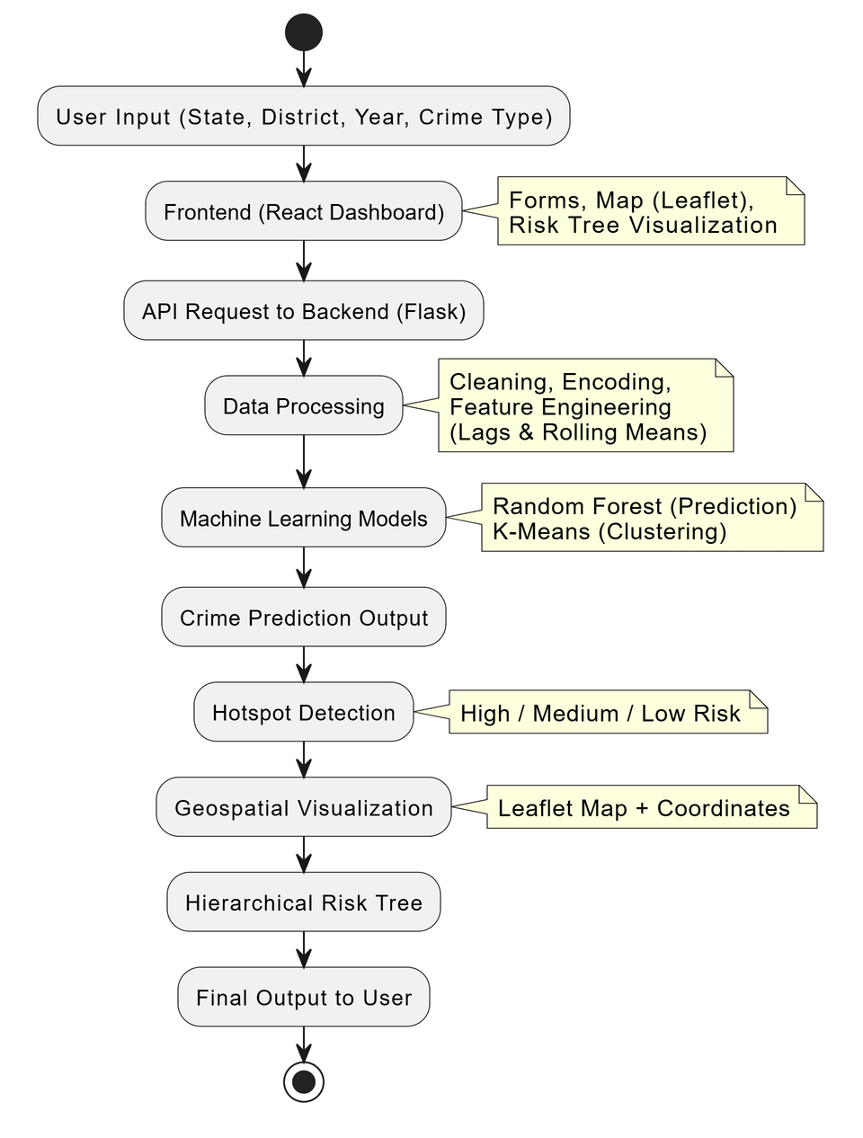
System Architecture
User Input: The user selects required inputs such as State, District, Year, and Crime Category through the dashboard.
Frontend Interface: The system displays input forms, interactive maps, and risk tree visualizations using React and Leaflet.
API Communication: The frontend sends requests to the backend through REST APIs for processing.
Data Processing: The backend performs data cleaning, feature engineering (lag features & rolling averages), and encoding.
Machine Learning Processing: The system uses Random Forest for crime prediction and K-Means clustering for hotspot detection.
Risk Classification: Districts are categorized into High, Medium, and Low risk based on hybrid logic.
Visualization: Results are displayed using an interactive map and hierarchical tree structure.
Final Output: The system provides clear insights for decision- making and crime prevention.

Slide 14
Results
The system successfully integrates data analysis, machine learning, and visualization into a unified platform.
The Random Forest model achieved 89% accuracy, ensuring reliable crime prediction results.
Hotspot detection is effectively achieved using K-Means Clustering, classifying districts into High, Medium, and Low risk zones.
The hybrid approach improves accuracy by combining clustering with threshold- based logic.
The interactive Leaflet map provides clear geographical visualization of crime- prone areas.
The hierarchical risk tree enables structured and easy interpretation of risk distribution.
The system supports real-time insights, helping in better decision-making and crime prevention.

Slide 15
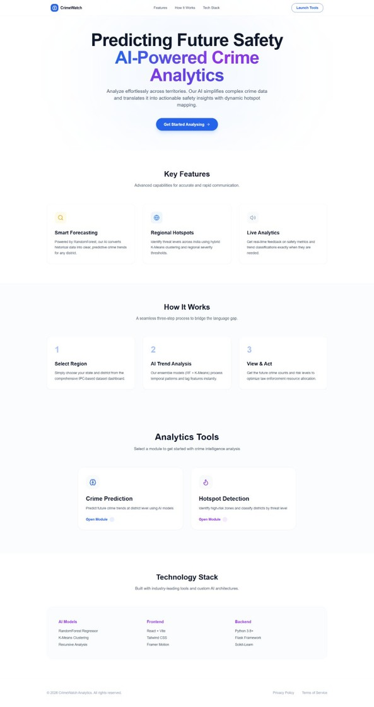
Output Screenshots

Slide 16
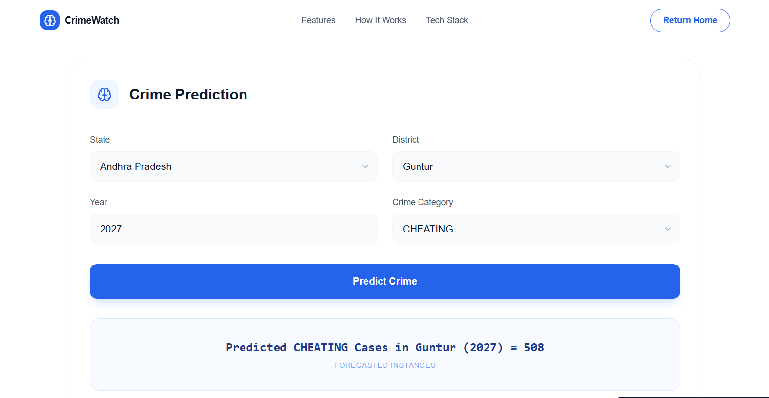
Output Screenshots

Slide 17
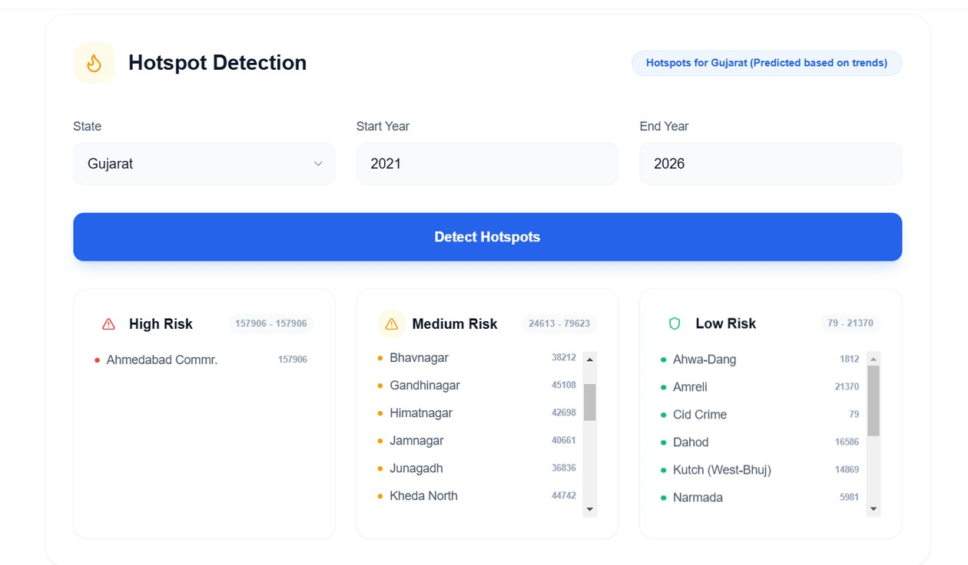
Output Screenshots

Slide 18
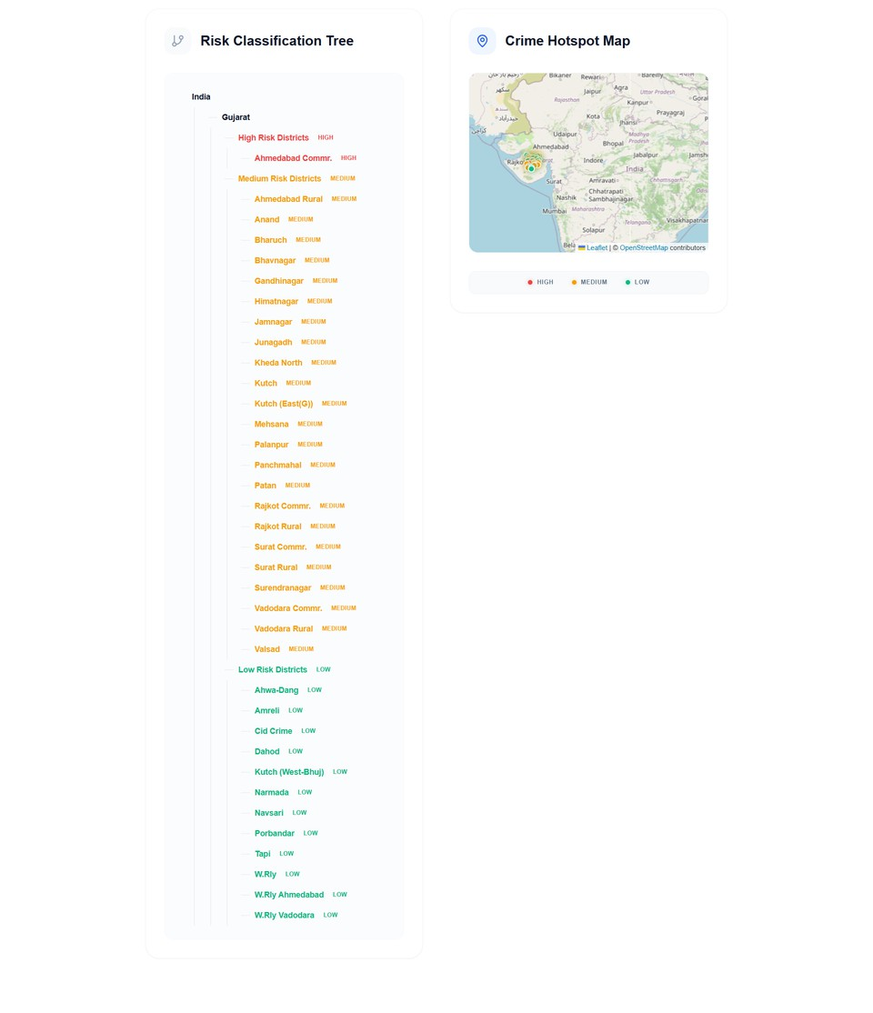
Output Screenshots

Slide 19
Conclusions
The project successfully developed an AI-based crime prediction and hotspot detection system using historical data.
The Random Forest model achieved 89% accuracy, providing reliable crime forecasts.
K-Means clustering effectively identified crime-prone areas by classifying districts into risk levels.
The integration of interactive Leaflet maps and hierarchical visualization improved understanding of crime distribution.
The system enables data-driven decision-making, helping authorities allocate resources efficiently.
Overall, the solution promotes proactive crime prevention and enhanced public safety.

Slide 20
Future Scope
Integrate real-time crime data from live sources for more accurate and up-to-date predictions.
Enhance prediction models using advanced algorithms like Deep Learning and LSTM for better time-series forecasting.
Expand the system to include crime type-wise analysis and detailed insights.
Implement mobile application support for easy access by authorities and the public. Incorporate heatmaps and advanced geospatial analytics for better visualization of crime patterns.
Enable alert systems and notifications for high-risk areas to support quick action.
Extend the system to cover other regions or countries for broader applicability.

